Slide 1
AI-Enhanced Student Skills Development Tracker
Mid-term report
Xin Guan

Slide 2
01
03
05
Project Purpose & Educational Context
02
Current Progress
04
Next Steps
System Architecture
Challenges & Solutions

Slide 3
Project Purpose & Educational Context
PART ONE

Slide 4
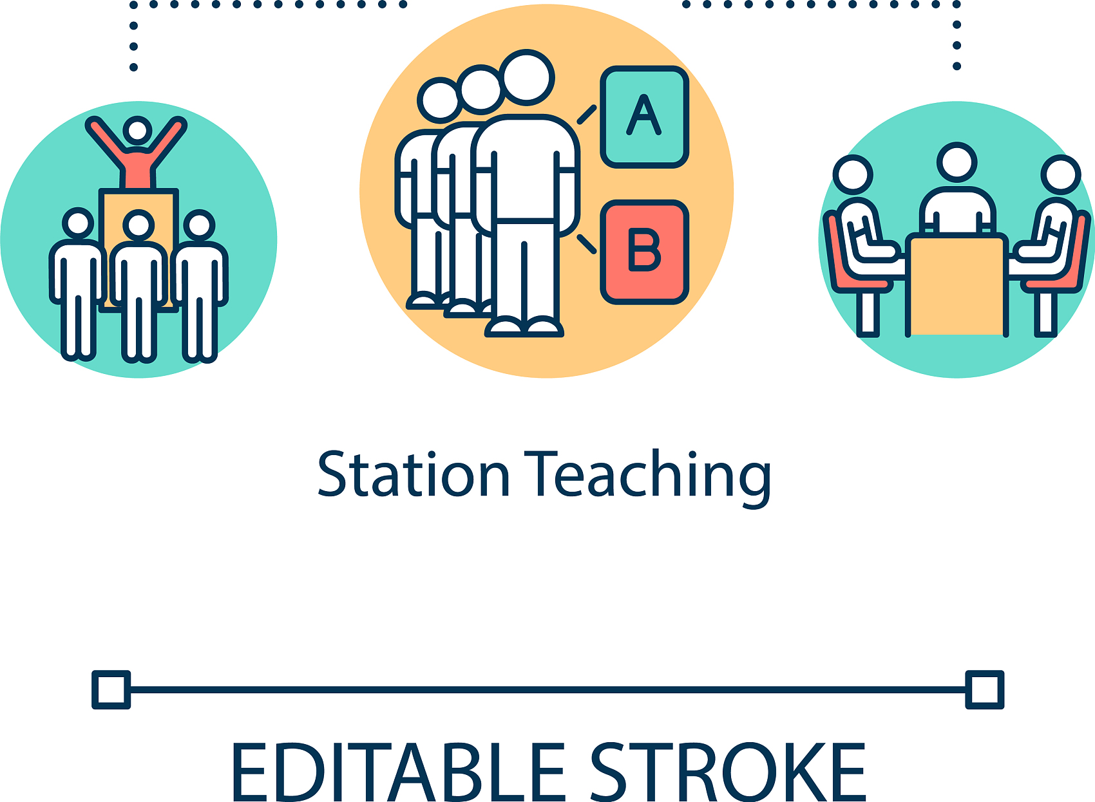
Rethinking
Skill
Assessment
Practical Limitations of Traditional Assessment
Traditional grading in group projects often focuses on the final output, like a project report or a presentation. For example, in a software development group project, instructors mainly consider the functionality and appearance of the software. This approach overlooks the behind - the - scenes efforts of team members.

Slide 5
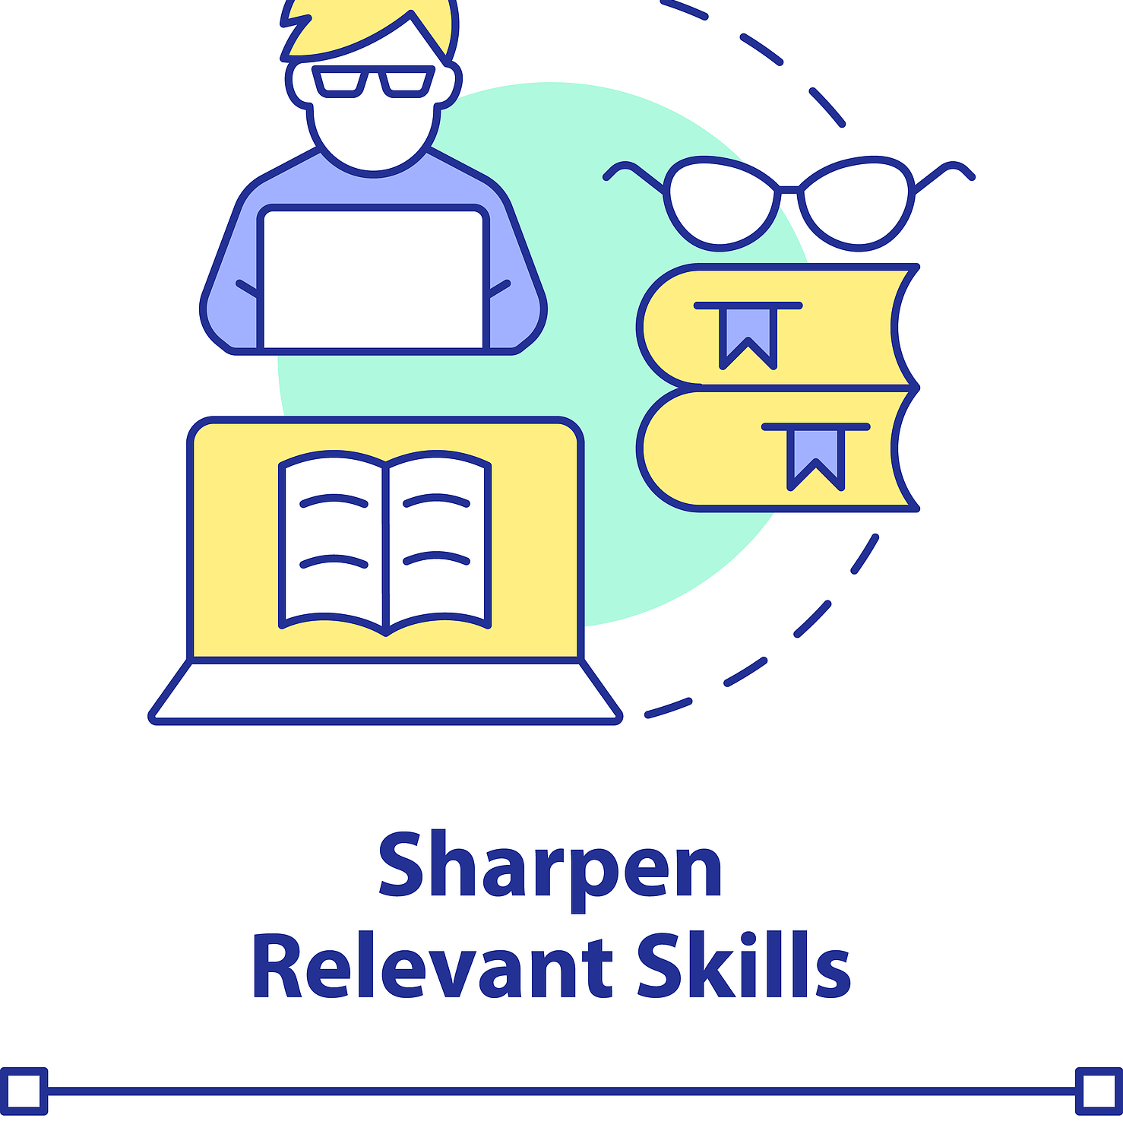
Rethinking Skill Assessment
Neglect of Implicit Collaboration
Skills such as coordinating resources, resolving conflicts silently, and building knowledge - sharing platforms are crucial in collaboration. However, traditional assessment rarely measures these implicit contributions. A student who spends hours behind the scenes on these tasks may not be recognized in the grading system.

Slide 6
Rethinking Skill Assessment
Core elements of effective collaborator
(1) Engagement
Definition: The ability of collaborators to drive the achievement of team goals through substantial contributions (e.g., task division, idea generation).
(2) Communication Efficacy
Definition: The clarity and bidirectionality of information transfer.
(3) Accountability
Definition: The fulfillment of team commitments and respect for others' contributions, providing specific, actionable, and emotionally positive peer feedback.

Slide 7
System Architecture
PART TWO

Slide 8
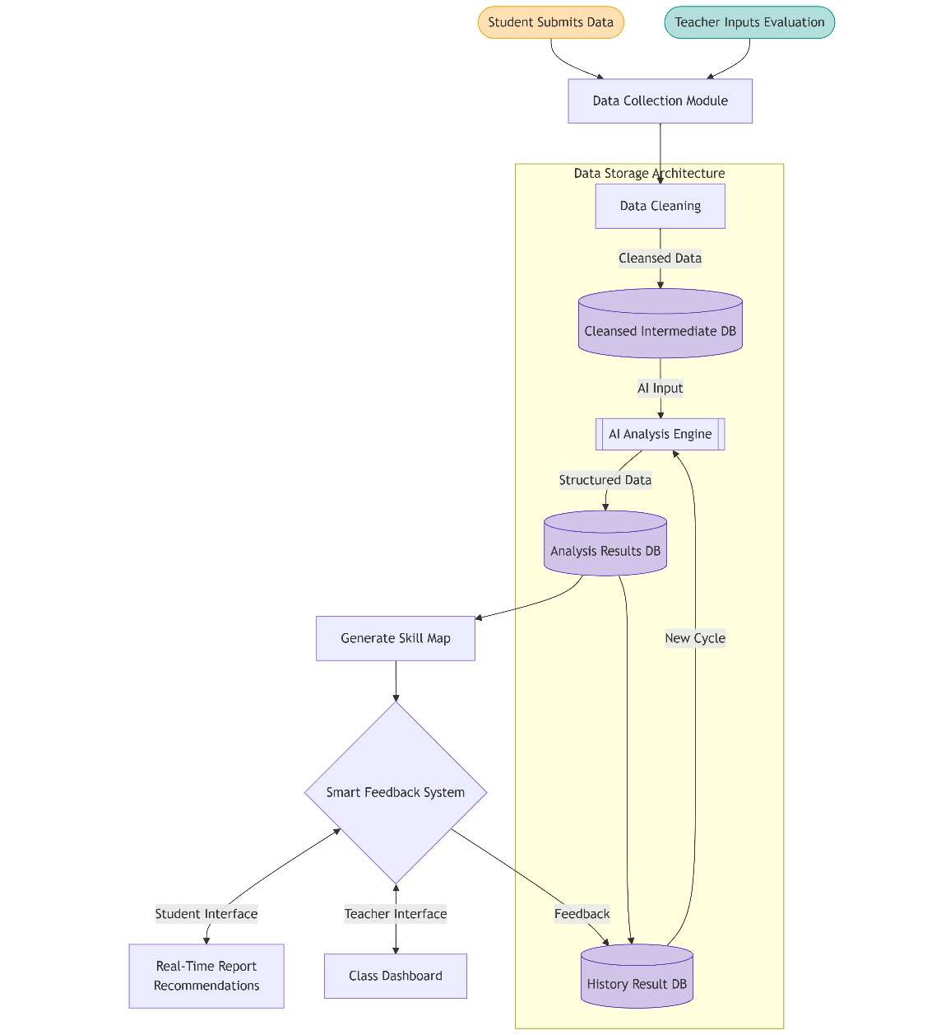
Modular Design Flowchart
(1) Data Collection
The first step in the system is to collect data input. The system collects data through submitted jobs or other forms of data.
(2) AI Analysis & Skill Map Generation
The cleaned data is fed into an AI Analysis Engine, which uses algorithms to score students on different dimensions of collaboration.
(3) Feedback generation and Smart Feedback System
The system will generate personalized feedback based on the analysis results.
(4) Data Storage
All data and feedback are stored in a database

Slide 9
Current Progress
PART THREE

Slide 10
Prototype Demonstration
Prototype Design
Based on a collaborative capability assessment framework determined above, a prototype system has been build based on NLP, which can automate the entire process of data acquisition, AI analysis, and feedback generation.
In the current phase of the project, the main goal is to design a functional prototype that can be used to achieve a simple collaboration capability assessment based on student participation in academic activities. The system is able to score from 0 to 5 on different dimensions based on pre-designed input text data and provide insights and feedback.

Slide 11
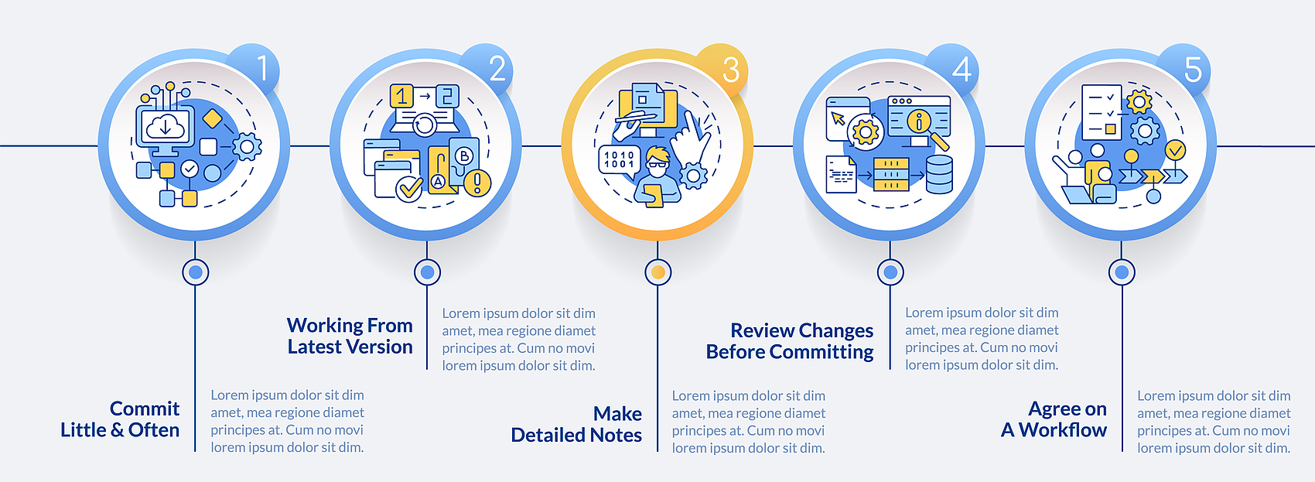
Open-Source Repository
Model Deployment Pipelines
Our model deployment pipelines on GitHub simplify the process of deploying the models. They include scripts and configurations for setting up the environment, installing dependencies, and deploying models such as DeepSeek-R1, making it easier for others to reproduce and build on our work.

Slide 12
Challenges & Solutions
PART FOUR

Slide 13
Challenges & Solutions
Problems:
1.Functional limitations of the system: the current system only realizes the feedback ability for the text quality of group assignments, and the current system has not realized long-term tracking
2.Data diversity Limitation: The existing system features only cover text document reading and writing
3.Lack of user interaction: The current system has not implemented user-friendly data visualization
4.Hardware limitations: System response time is slow

Slide 14
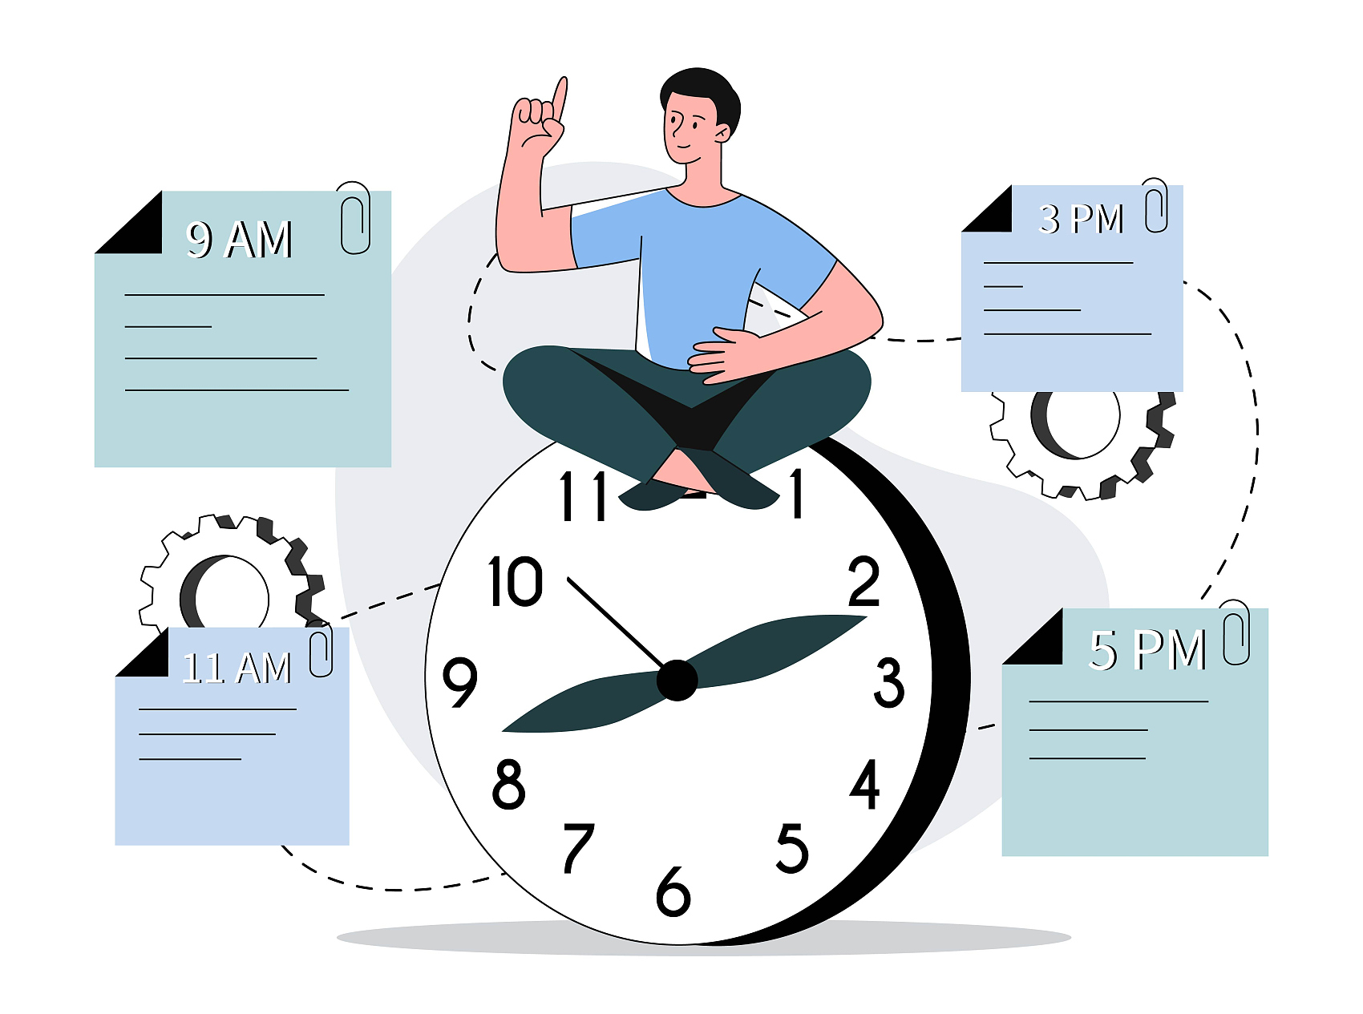
Challenges & Solutions
Solutions:
1.Function expansion: multi-modal data access to achieve comprehensive analysis of different types of data in group work; Design historical track database to realize long-term tracking
2.Report readability optimization: Design a feedback template engine to provide visual analysis results and reports
3.Cloud migration: Deploy the system to the cloud

Slide 15
Next Steps
PART FIVE

Slide 16
Roadmap Implementation
1.Core task: Complete a fully functional circular recommendation system
2.Ability Map: Correlate collaborative ability data with academic achievement to build a visual growth path for students.
3.Adaptive recommendation engine: track and record students' growth, and automatically push resources according to weaknesses (such as weak conflict resolution ability → recommend to strengthen learning in this field).

Slide 17
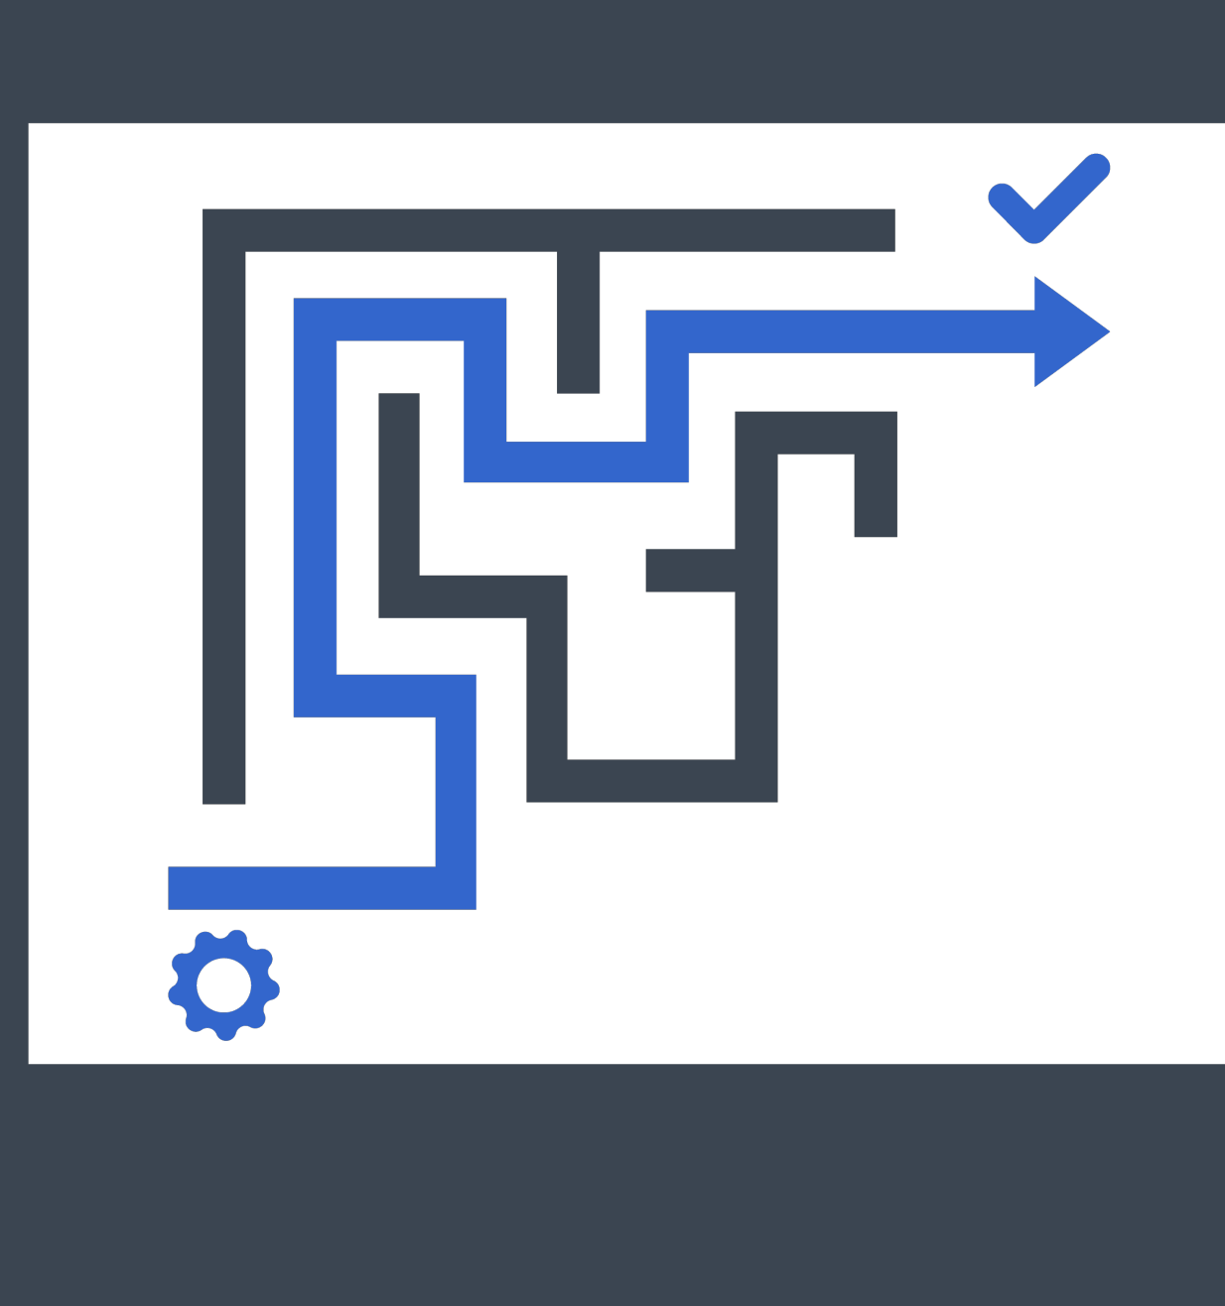
Roadmap Implementation
LoRA-based Recommendation Engine
The LoRA-based recommendation engine will be a key part of our system. By fine-tuning with LoRA, it can analyze students' weaknesses, such as a lack of conflict resolution ability. Then, it will automatically recommend targeted learning resources to help students strengthen in these areas.

Slide 18
Thanks for listening
Xin Guan

